Slide 1
NEWS APP
Presented By-
Group-F
Kaneez Fathima Razvi
Kavitha Boda
Varshitha Shivakumar
Vyshnavi Bussa

Slide 2
TECHNOLOGIES USED IN BACKEND & FRONTEND :
BACKEND:
FRONTEND:
SPRING BOOT
SPRING SECURITY
MYSQL
JUNIT, MOCKITO (TESTING)
DOCKER
POSTMAN
SWAGGER
HTML
CSS
JAVASCRIPT
BOOTSTRAP
ANGULAR
ANGULAR MATERIALS

Slide 3
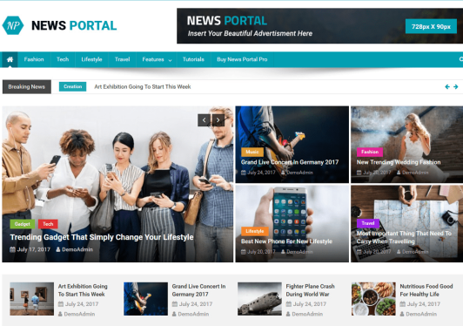
ABSTRACT
Its a system to search for news article, open the article and add an article to favourite list.
This news app has three main services i.e, Admin, User and favourite .
Admin can add the news and delete the news in this app.
User can view and search for an article , open interested news article.
User can add the news to their favourite list after register and logging in to the app.

Slide 4
FLOW OF FRONT-END
Admin
Login
Add or Delete News
User
View the News and Add the News
to Favourites
Register
Login
Favourite
Add the News to the Favourite Collection

Slide 5
MANAGEMENT SYSTEMS
ADMIN
USER
The user will be able to view the news and add the news to favourite lists.
The user will be able to view the news that he has added to the favourite list in the favourite lists tab.
If the user doesn’t want any particular news in favourite list he can remove it from his/her favourite lists.
Add/delete news content to the website.
Admin can view the news which users have added to the favourite list.

Slide 6
TESTING
Once source code has been generated ,software must be tested to uncover as many errors as possible before making it available for the client.
Which is crucial for the system to operate well and produce high-quality software.Testing includes designing a series of test cases that have a high likelihood of finding errors by applying software-testing techniques.
Software testing is a critical component of the software engineering process.
It is part of the process of ensuring the quality of software (SQA)
System testing logically assumes that the objective will be effectively attained if every component of the system is correct.
Logically examining the system is recommended.
Avoids record duplications that result in data redundancy.

Slide 7
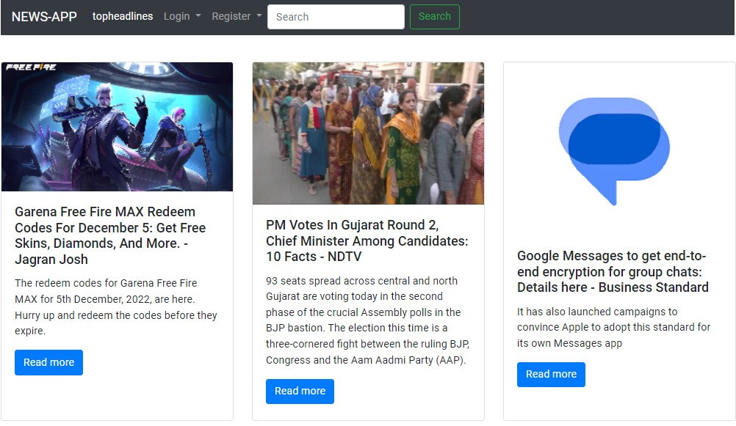
LOOK OF NEWS APP

Slide 8
ASSIGNED WORK
Kaneez Fathima Razvi –Admin service
Varshitha Shivakumar – Testing,Swagger,Components of Admin page
Bussa Vyshnavi – User service
Boda Kavitha – Favourite service

Slide 9
THANK YOU

